Slide 1
2.Asp.net MVC Core
1.Converting Console App to Web APP
2.What is routing in MVC

Slide 2
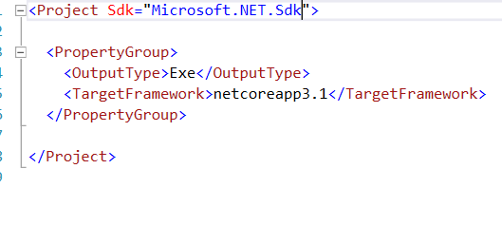
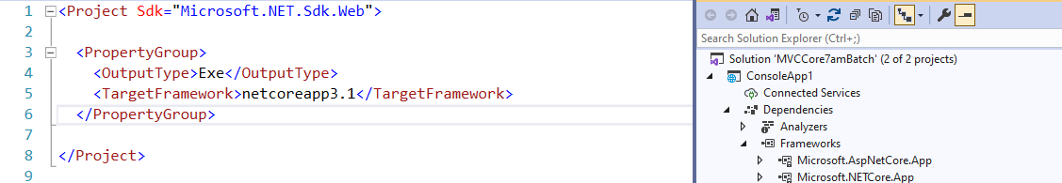
Converting Console App to Web
Step 1:Create Console Application
Step 2:Edit edit .csproj

Slide 3
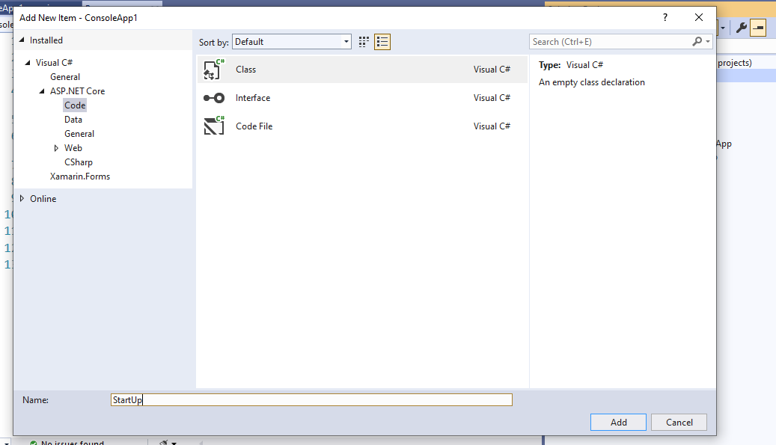
Add Start up Class

Slide 4
Add in Program.cs
public static void Main(string[] args)
{
CreateHostBuilder(args).Build().Run();
}
public static IHostBuilder CreateHostBuilder(string[] args) =>
Host.CreateDefaultBuilder(args)
.ConfigureWebHostDefaults(webBuilder =>
{
webBuilder.UseStartup<Startup>();
});

Slide 5
Import nameSpace
using Microsoft.AspNetCore.Hosting;
using Microsoft.Extensions.Hosting;

Slide 6
Add in Statup Class
public void ConfigureServices(IServiceCollection services)
{
services.AddControllersWithViews();
}
public void Configure(IApplicationBuilder app, IWebHostEnvironment env)
{
app.UseRouting();
app.UseEndpoints(endpoints =>
{
endpoints.MapDefaultControllerRoute();
});
}

Slide 7


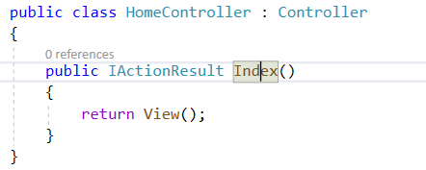
Add Controller and Views

Slide 8
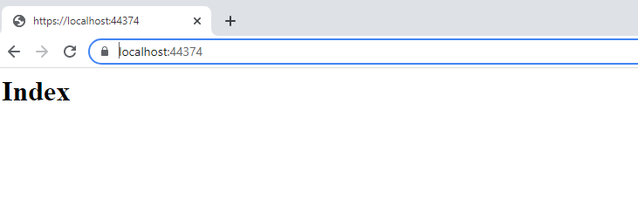
Output

Slide 9
app.UseEndpoints(endpoints =>
{
endpoints.MapControllerRoute(
name: "default",
pattern: "{controller=Home}/{action=Index}/{id?}");
});

Slide 10
Different Conventionals Route
endpoints.MapControllerRoute(
name:"test",
pattern:"test/time",
defaults: new {controller="Home",action="index"}
);
endpoints.MapControllerRoute(
name: "test2",
pattern: "{controller=home}/{action=index}/{id?}");

